Slide 1
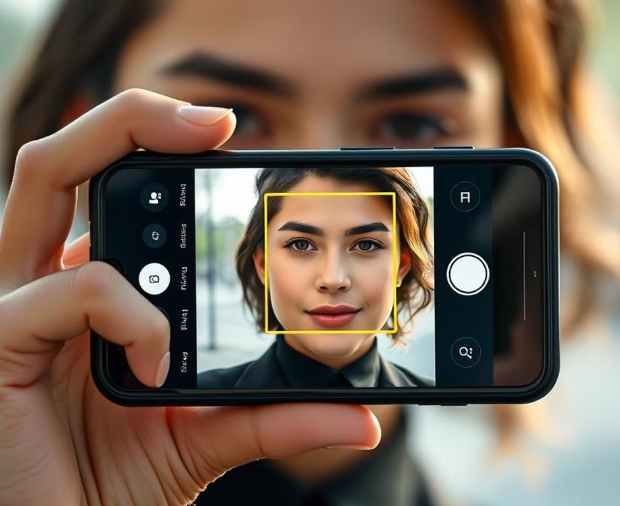
OpenCV : A Tool for Real-Time Face Detection
FACE
DETECTION
By SAI NANGARE & NANDINI MATE.

Slide 2
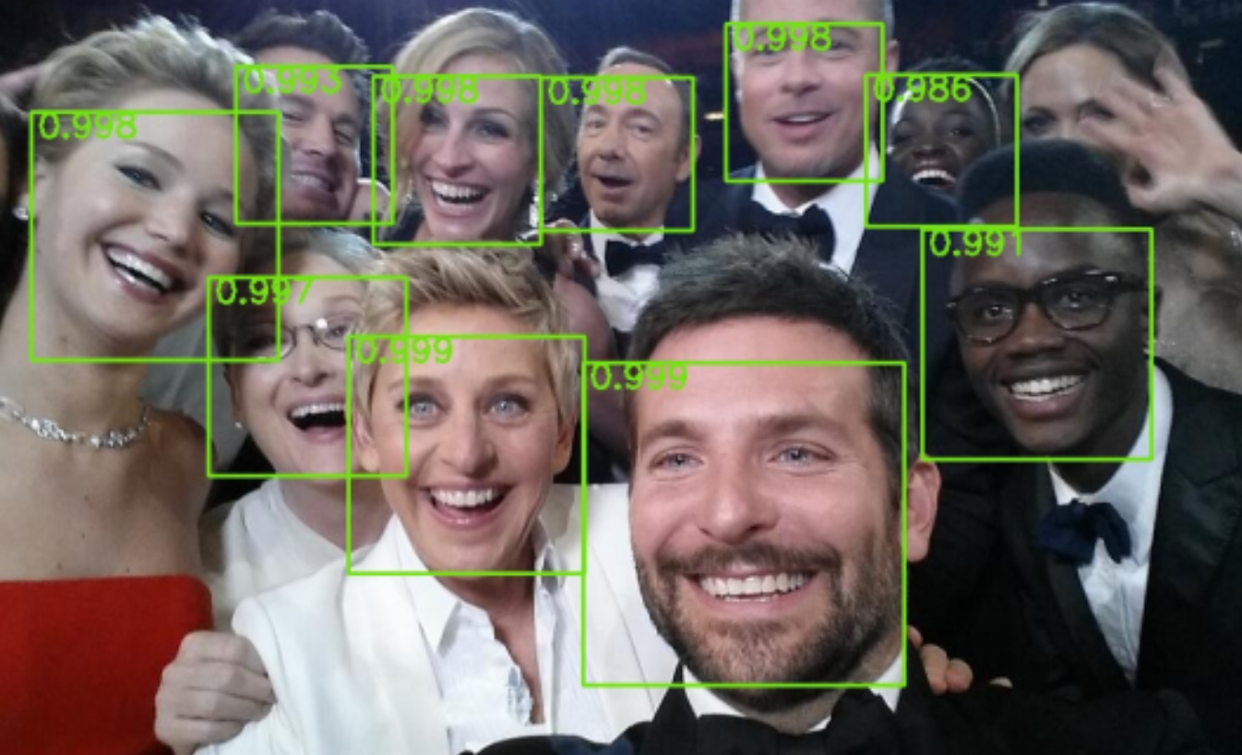
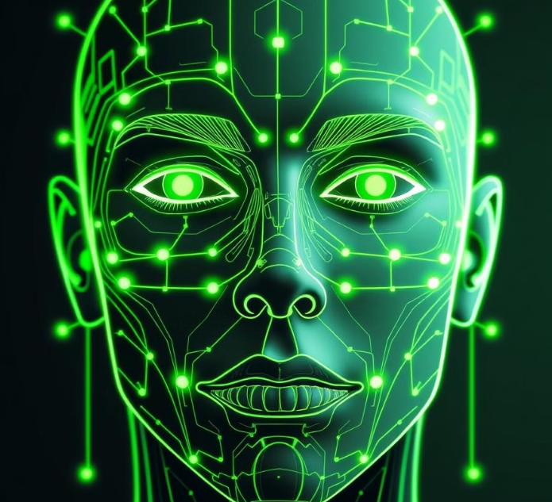
What Is OpenCV?
OpenCV, short for Open Source Computer Vision Library.
It plays a major role in real-time operation which is very important in today’s systems.
It provides a wide range of algorithms for image and video analysis, making it suitable for various tasks.

Slide 3

Face Detection Algorithm:
Haar Cascade Classifiers
These are pre-trained machine learning models that identify features characteristic of faces.
Deep Learning Models
OpenCV's deep learning algorithms, that enable tasks such as image classification and object detection by processing image features.
Real-Time Processing
These algorithms are optimized for speed and accuracy, enabling near-instantaneous detection in real-time applications

Slide 4
import libraries(cv2) Initialize face detector Start video capture Capture frame from video Detect faces and draw rectangles Display the resulting frame Exit on pressing 'q’ Release resources
Flow of Code

Slide 5
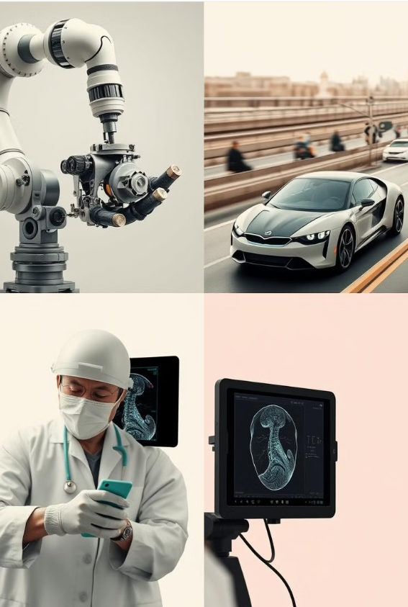
Applications of OpenCV
Robotics
Vision-guided navigation and manipulation for robots.
Self-Driving Cars
Object detection and lane tracking for autonomous navigation.
Medical Imaging
Analyzing medical images for disease diagnosis and treatment planning.
Security Systems
Facial recognition, motion detection, and intrusion detection.

